Slide 1
Team 1:
Place Recognition
Derek Reiersen, Esther Vasiete, Shuzhe Zhang,
Kelly Kaoudis, Margaret Wheeler, Jeeeun Kim

Slide 2
Project Overview
Place Recognition using two different methods
Bag of Words with SIFT descriptors
Features extracted from a Convolution Neural Network
Classify with One-Against-All SVM
Test for loop closure on Malaga Urban Dataset
Test for loop closure on custom local Boulder university urban campus dataset (clbuucd)

Slide 3
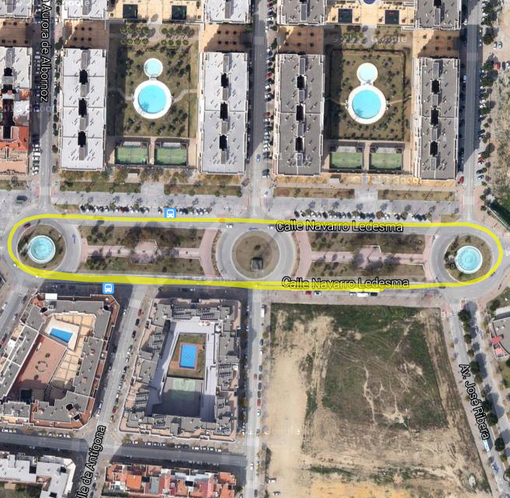
Malaga Urban Dataset Extract #7
“Short avenue loop closure”
~1700 raw stereo images
Dataset also includes camera data, GPS data, LIDAR data
Use left camera and GPS data
camera for place recognition
GPS data to visualize path and loop closure
http://www.mrpt.org/MalagaUrbanDataset

Slide 4
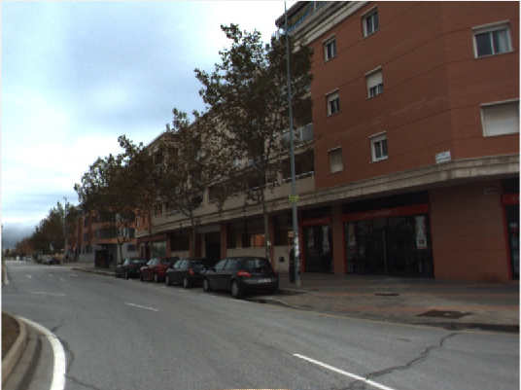
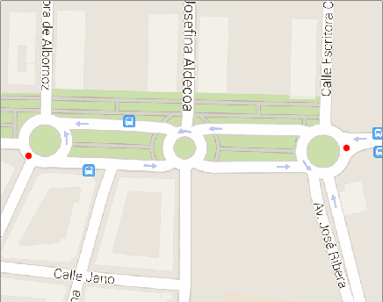

Slide 5
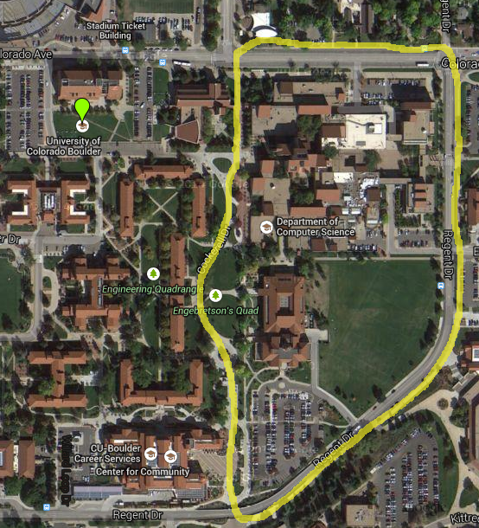
Campus Dataset, clbuucd
Short walking loop closure
248 images
Images distance ~22 ft
two complete loops
GPS data,mono images
Greater challenge than Malaga Urban Dataset
People in images
Walking, not driving
Fewer images overall

Slide 6
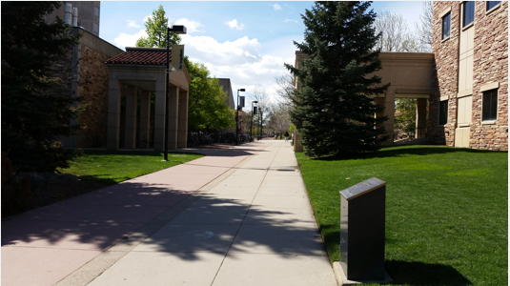
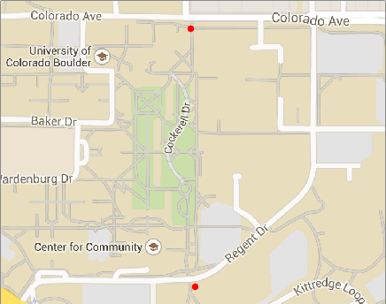

Slide 7
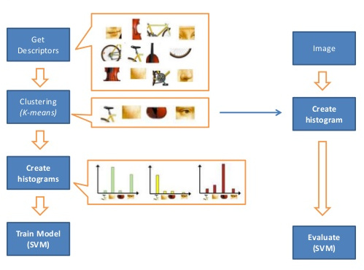
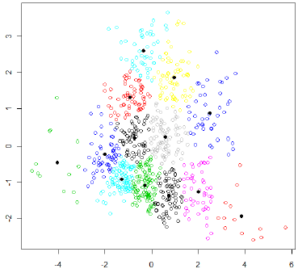
Method 1: Bag of Words
Def: treat an image like a text document, break up into visual “words”
Detect and extract dense SIFT feature descriptors
Normalize feature descriptors
K-Means clustering to create pictorial codebook
Create histogram(s) of visual words

Slide 8
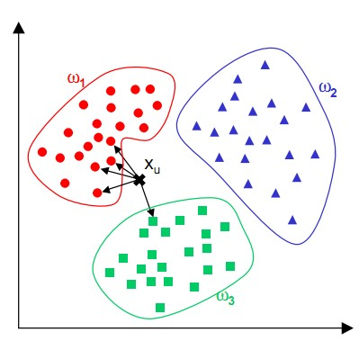
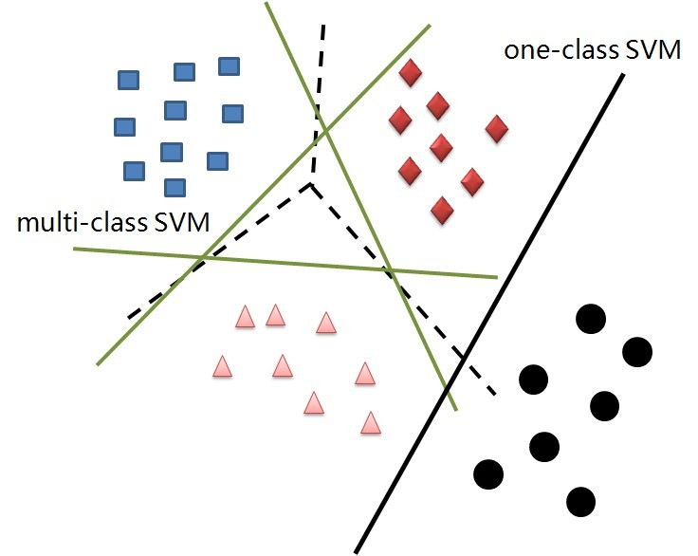
Bag of Words, continued
Use One-Against-All SVM to classify
K-Nearest Neighbours (Video Google)
SVM (Team 1)
Notes:
ADD IPCTURE HERE
<number>

Slide 9
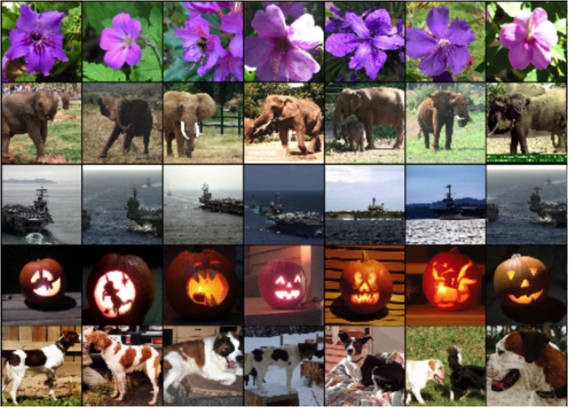
Method 2: CNN feature extraction
OverFeat
CNN = image classifier, feature extractor
Trained with the Torch7 package on the Imagenet dataset
Linux only...

Slide 10
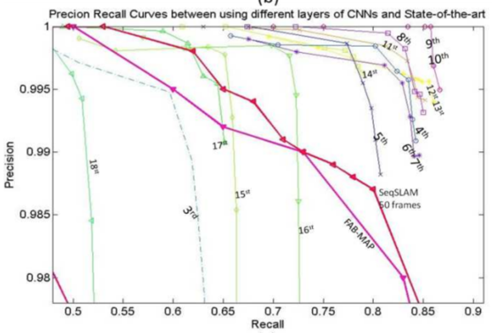
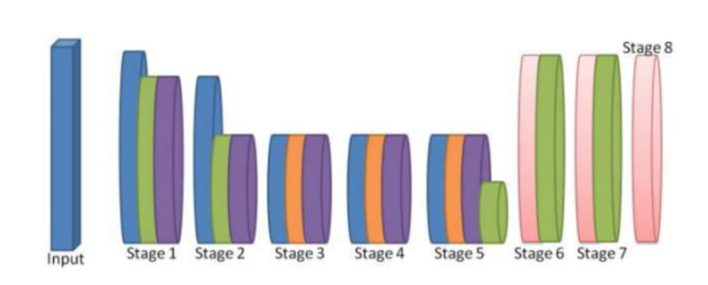
CNN features, continued
Feature: vector describing “pictorial word”
Extract features from layers 10 and 21
Convolutional Neural Network Based Place Recognition; Chen et al.

Slide 11
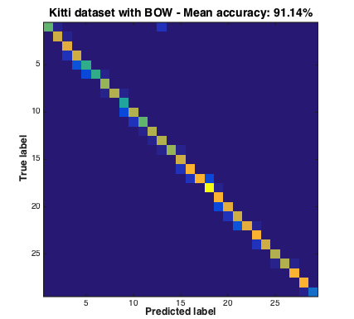
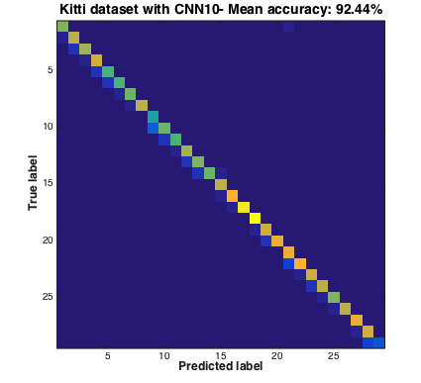
Confusion Matrices: Malaga Dataset

Slide 12
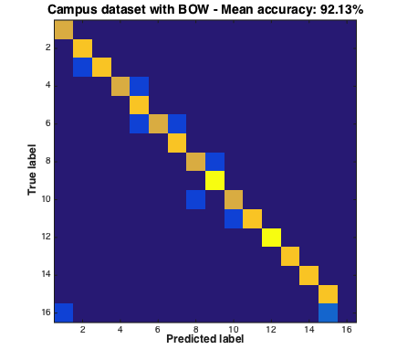
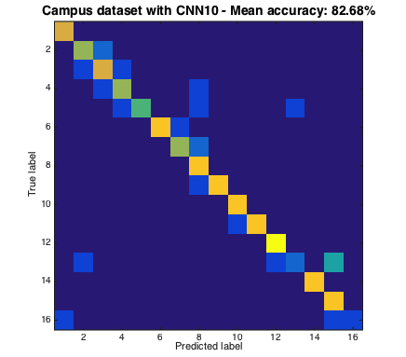
Confusion Matrices: clbuucd Dataset

Slide 13
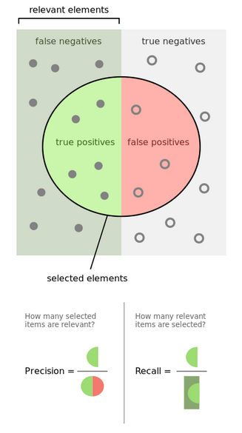
Precision-Recall Curve
tl;dr how well does the model separate the classes?
Recall = num relevant elements retrieved / num relevant elements overall
Precision = num relevant elements retrieved / total # elements retrieved

Slide 14
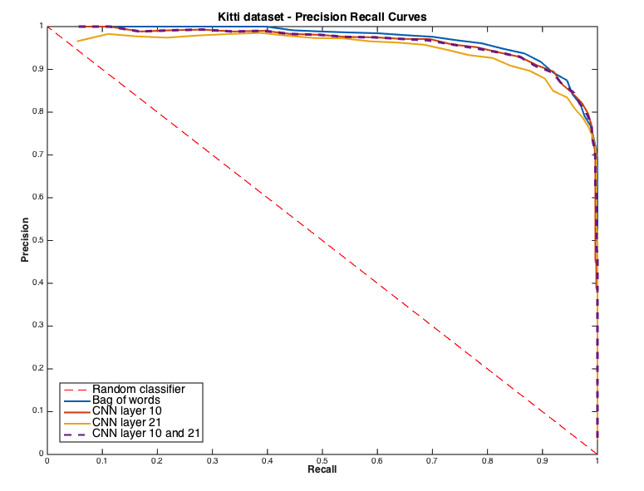
Malaga Precision-Recall

Slide 15
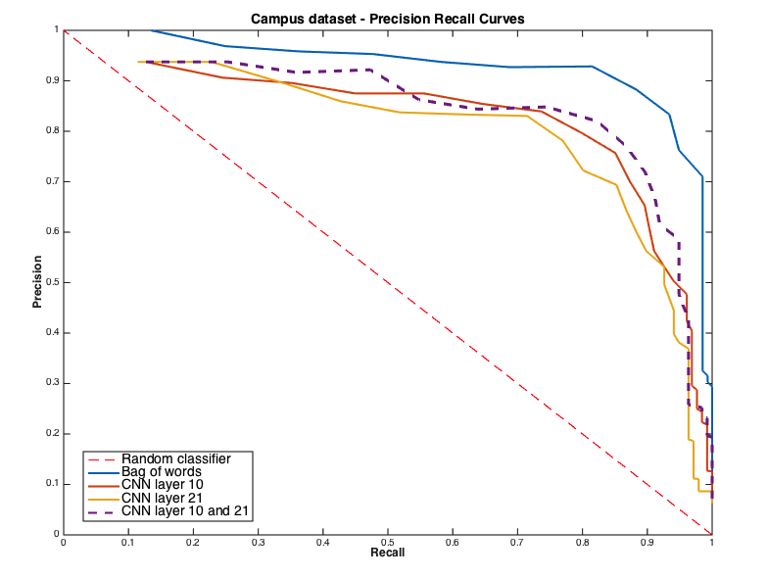
cluubcd Precision-Recall

Slide 16
Neural network training experiment
We made a pre-trained neural network work, how about trying to train a CNN on our own data?
Caffe: deep learning framework out of UC Berkeley
Imagenet framework on Malaga Dataset Extract #7
In general: train on images from first loop, classify on images from second loop
Results may likely improve with a larger dataset
http://caffe.berkeleyvision.org/

Slide 17
Results and Future Work
Video Google-style BoW worked well on our small datasets
BoW with OverFeat also worked well
Caffe needs a little work
Trying larger datasets?
Different feature normalization methods?
HoG and other kinds of descriptors?

Slide 18
Sources
Video Google: robots.ox.ac.uk/~vgg/publications/papers/sivic03.pdf
Overfeat: github.com/sermanet/OverFeat
CAFFE: caffe.berkeleyvision.org/

